Slide 1
Promise of Generative AI
in Healthcare
30 November 2023
Company Confidential: Data-Core Healthcare | datacorehealthcare.com
Notes:
Good morning, ladies and gentlemen! My name is P.K. Banerjee, and I am the General Manager of Data-Core Healthcare. Today we will be embarking on an intriguing journey into the realm of Generative AI, a revolutionary branch of Artificial Intelligence and the promise it holds for the Healthcare industry.

Slide 2
Table of Contents
Section 1 Introducing Generative AI
Section 2 GenAI Models
Section 3 GenAI vs. Traditional AI
Section 4 GenAI in Healthcare
Section 5 Managing the Risks of GenAI
Section 6 What can GenAI do for You?
Company Confidential: Data-Core Healthcare | datacorehealthcare.com
Notes:
We start our journey with an introduction to Artificial Intelligence and Generative AI with some historical perspective and the current state of affairs.
We take a peek at the two core structures which are the driving forces behind its powerful capabilities.
Moving beyond the technicalities, we contrast Generative AI with Traditional AI, spotlighting the features that set it apart and position it as a catalyst for innovation.
We then shift focus to the potential enhancements and efficiencies Generative AI can bring to the Healthcare industry, specifically with respect to patient engagement and operational efficiencies.
However, as with any technological marvel, there are risks, and we must learn how to use this tool in a responsible manner. We will talk about some of these risks and what to look out for.
Finally, we address the crucial question — What can Generative AI do for you?—offering insights into how this technology aligns with your business objectives and opens new horizons for advancement.
Join us in this exploration, ask questions, and let us together unlock the Promise of Generative AI in transforming Healthcare.

Slide 3
01
Introducing Generative AI
Company Confidential: Data-Core Healthcare | datacorehealthcare.com

Slide 4
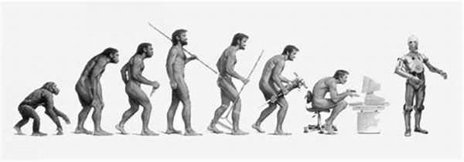
What is Artificial Intelligence?
Intelligence:
Ability to solve complex problems and make decisions for positive outcomes.
Refined this cognitive ability through millions of years of Human evolution.
Artificial Intelligence
Can machines possess human-like intelligence?
Machine Intelligence or Artificial Intelligence as opposed to our natural intellect.
The Turing Test:
Alan Turing's pivotal contribution to AI assessment ^{[2]}.
Evaluating a machine’s ability to exhibit intelligence comparable to humans.
image source – [1]
Company Confidential: Data-Core Healthcare | datacorehealthcare.com
Notes:
You must be aware by now that Generative AI has taken the industry by storm. But before we get going with Generative AI, let’s pause for a moment and consider what AI or Artificial Intelligence is.
“Intelligence” can be defined as the ability to solve complex problems and make decisions with outcomes benefiting the actor. We, humans, have acquired this ability as a result of millions of years of evolution.
But what about machines? Philosophers have, throughout the ages, pondered on the question, “can machines think?”. Or, in other words, the possibility of machines acquiring this rare capability that we call intelligence. This is what is referred to as Artificial Intelligence or AI as opposed to the Natural Intelligence that We possess.
Which brings us to Alan Turing and the Turing Test. Alan Turing was an English mathematician who is widely considered to be the father of theoretical computer science and artificial intelligence. Many of you may have seen the biographical thriller movie, “Imitation Game”, which depicts the genius of Alan Turing and how he deciphered German Enigma messages during World War II. But what you may not know, Imitation Game was the name of a Test – commonly known as the Turing Test. The test was devised to guage a machine's ability to exhibit intelligent behavior equivalent to, or indistinguishable from, that of a human. Any machine that passes the Turing Test can be said to posses Artificial Intelligence. But I digress. Let's get back to today’s topic.
AI has seen a lot of activity in the past decade and comes in many different flavors - one of them is Generative AI.

Slide 5
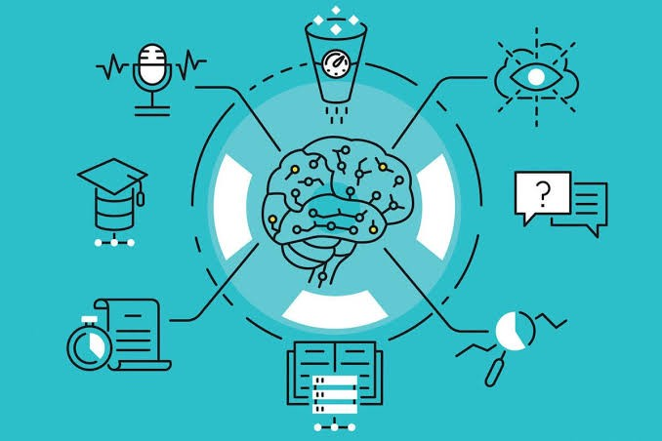
Generative AI : Definition
Generative Artificial Intelligence (also Generative AI or GenAI) refers to a branch of Artificial Intelligence (AI) used to create new content like text, images, music, audio, video, speech, and even software code or product designs.
GenAI models like Generative Pre-trained Transformer (GPT) learn the patterns and structure of their input training data and then generate new data that has similar characteristics.
image source – [3]
Company Confidential: Data-Core Healthcare | datacorehealthcare.com
Notes:
Generative AI, often referred to as GenAI, represents the newest frontier in AI technology. It is the creative powerhouse of AI, capable of autonomous generation of valuable content, whether it is text, images, or other types of media. It's like having an AI helper at YOUR disposal.
Machine Learning, as you all know, is at the core of AI. Different machine learning models are used depending on the domain, the characteristics of the dataset being used, and the desired outcome.
GenAI currently uses a “Generative Pre-trained Transformer” model - a GPT. And that’s where the name ChatGPT comes from!

Slide 6
Generative AI: A Brief History
1950s
Founding of AI as an academic discipline.
Early 2000s
Emergence of Deep Learning & Natural Language Processing (NLP).
2014
First practical Deep Neural Networks capable of learning generative models.
2017
The Transformer network enables advancements in generative models.
2018
The first Generative Pre-trained Transformer (GPT), known as GPT-1
2019
Followed by GPT-2 which uses a Foundation Model.
2021
Release of DALL-E and high-quality AI art from natural language prompts.
2023
GPT-4 released.
Company Confidential: Data-Core Healthcare | datacorehealthcare.com
Notes:
Here is a brief history of Generative AI.
Artificial Intelligence started as an academic discipline about 70 years ago, back in the mid 1950s. While foundations of AI were laid at that time, it was soon realized that running these algorithms efficiently would require tremendous processing power and memory, which was not available at that time. Consequently, AI entered a period of hibernation which lasted a few decades.
With growth of computing power and falling costs of memory, AI saw a resurgence in the early 2000s with Deep Learning algorithms and Natural Language Processing or NLP. NLP is used extensively in GenAI to interpret human communications and to generate content which can be easily understood by humans.
Fast advancements in the field led to the release of the first GPT model, aptly named GPT-1 <smile>, in 2018. Better and more powerful models quickly followed, bringing us to GPT4 in 2023. This is now creating the loudest buzz in technology circles.
Generative AI holds tremendous promise. However, as you can see, it is a relatively new technology, and we are all learning where and how it can be best used.

Slide 7
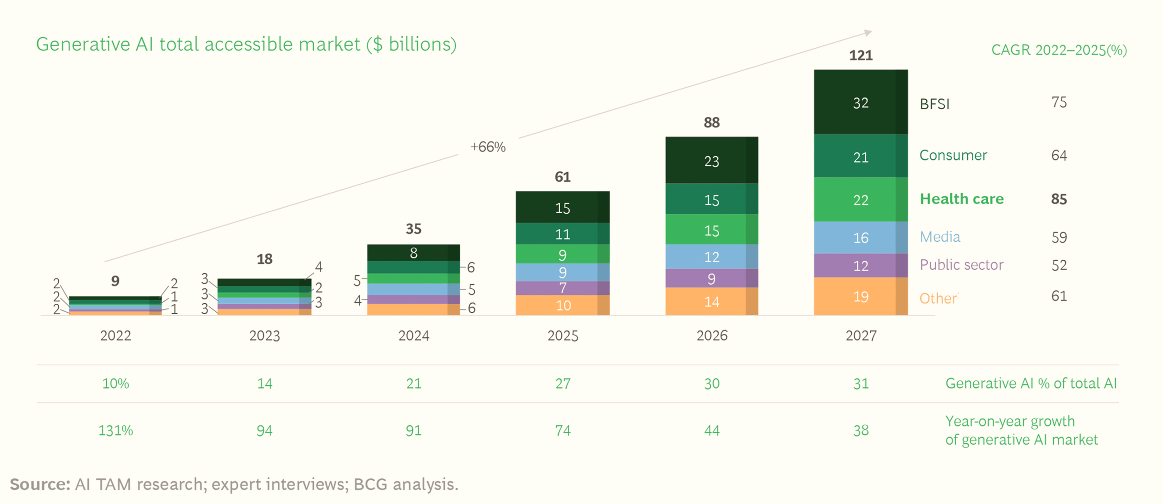
Generative AI : Total Accessible Market
image source – [4]
Company Confidential: Data-Core Healthcare | datacorehealthcare.com
Notes:
Before we dive into the applications of GenAI, let’s take a quick look at its market potential.
Generative AI is projected to grow faster in healthcare than in any other industry, with a compound annual growth rate or CAGR of a staggering 85% through 2027.
The Total Accessible Market or TAM is expected to reach $22 billion by that same year.
These numbers clearly show the promise of Generative AI, and the need for its adoption in the Healthcare industry.

Slide 8
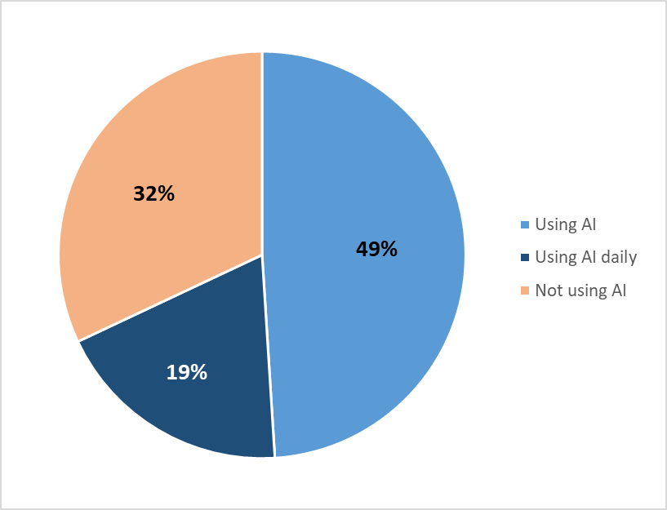
Generative AI : A Quick Survey
GenAI represents a meaningful new tool that can help unlock a piece of the unrealized $1 trillion of productivity improvement potential in the healthcare industry. ^{[5]}
68 percent of survey respondents in healthcare already use AI tools in their work, with 19 percent using them on a daily basis. ^{[6]}
Company Confidential: Data-Core Healthcare | datacorehealthcare.com
Notes:
What makes GenAI truly remarkable is its potential impact on all sectors including healthcare.
According to a recent research, Generative AI has the capacity to unlock an astonishing 1 trillion dollars in untapped potential within just the healthcare industry. It can do so by automating tedious operational work and bringing years of clinical data to his fingertips.
As we explore Generative AI further, do keep in mind that this isn't a far-off concept. It's already here, and it's making waves. In fact, a substantial 68 percent of respondents in a recent survey are already using some AI tools in their work. Interestingly, 19 percent within them are using these tools on a daily basis, highlighting the growing importance of AI in the healthcare industry.

Slide 9
02
GenAI Models
Company Confidential: Data-Core Healthcare | datacorehealthcare.com
Notes:
Now that we have been introduced to Generative AI, let us look at some technical aspects. I will try to keep it simple without getting into too much of the details. We’ll keep that for, maybe, some other day.

Slide 10
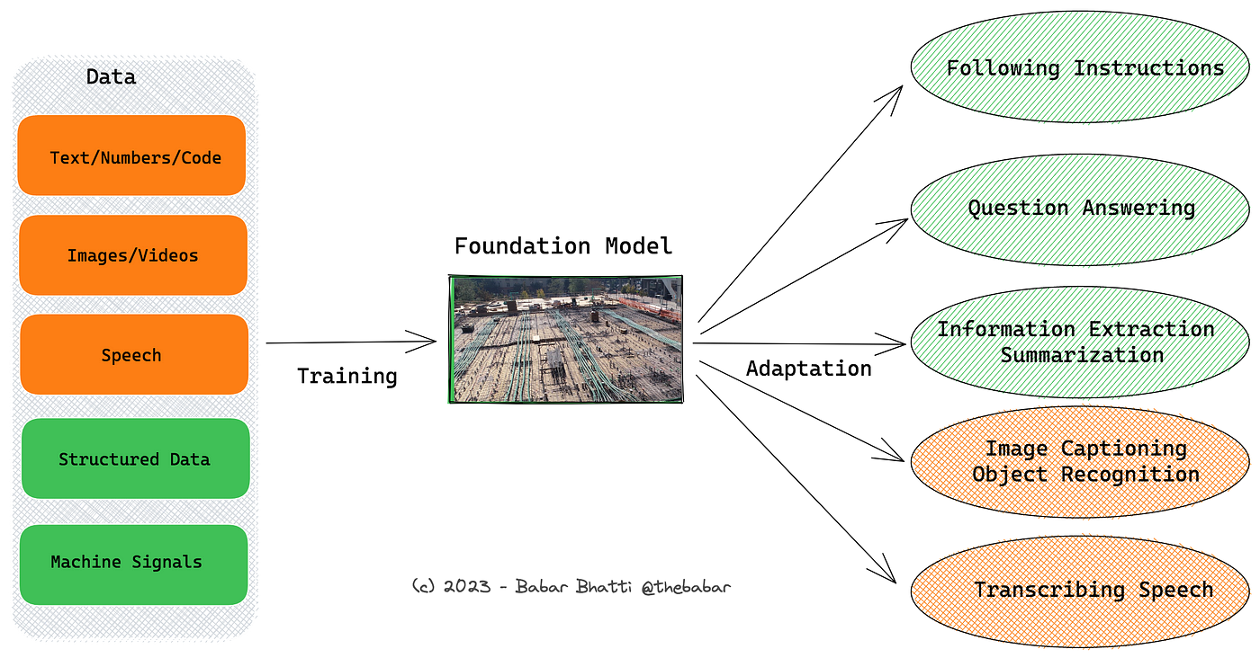
Foundation Models
A model that is trained on a broad dataset and can be adapted to a wide range of downstream tasks.
The data may be of a variety of types such as text, images, speech, or even programming code.
GPT-3, Dall-E 2 and (BERT) are all foundation models.
Foundation models are known for their generality and adaptability.
image source – [7]
Company Confidential: Data-Core Healthcare | datacorehealthcare.com
Notes:
Generative AI looks to replace the task-specific models used by Traditional AI with models that are trained on a broad set of unlabeled data. What does that mean? As you can see in the diagram here, input data may be of a wide variety of types – text, images, videos, speech, or even software code. The data is unstructured and not labeled by humans. The machine ingests this data and learns on its own, in an unsupervised or self supervised manner.
These models are called ‘Foundation Models’, or sometimes ‘General-Purpose AI’ or ‘GPAI’ systems. The models can be adapted to a range of tasks such as text synthesis, image manipulation and audio generation with minimal fine-tuning.
Foundation Models can be standalone systems or as the name suggests, can serve as the foundation for other downstream applications.
GPT-3, Dall-E 2, and BERT are all foundation models and they have already demonstrated tremendous possibilities. You can ask any question or input a short prompt and the model spits out an entire essay or an interesting picture. The point to note here is that the model may not have been specifically trained for the topic in question!
The strength of a Foundation Model lies in its ability to also apply the knowledge it has gained from one situation to another. This is similar to how you learn to drive on one specific car but without too much effort you are able to drive most other cars or even a truck!

Slide 11
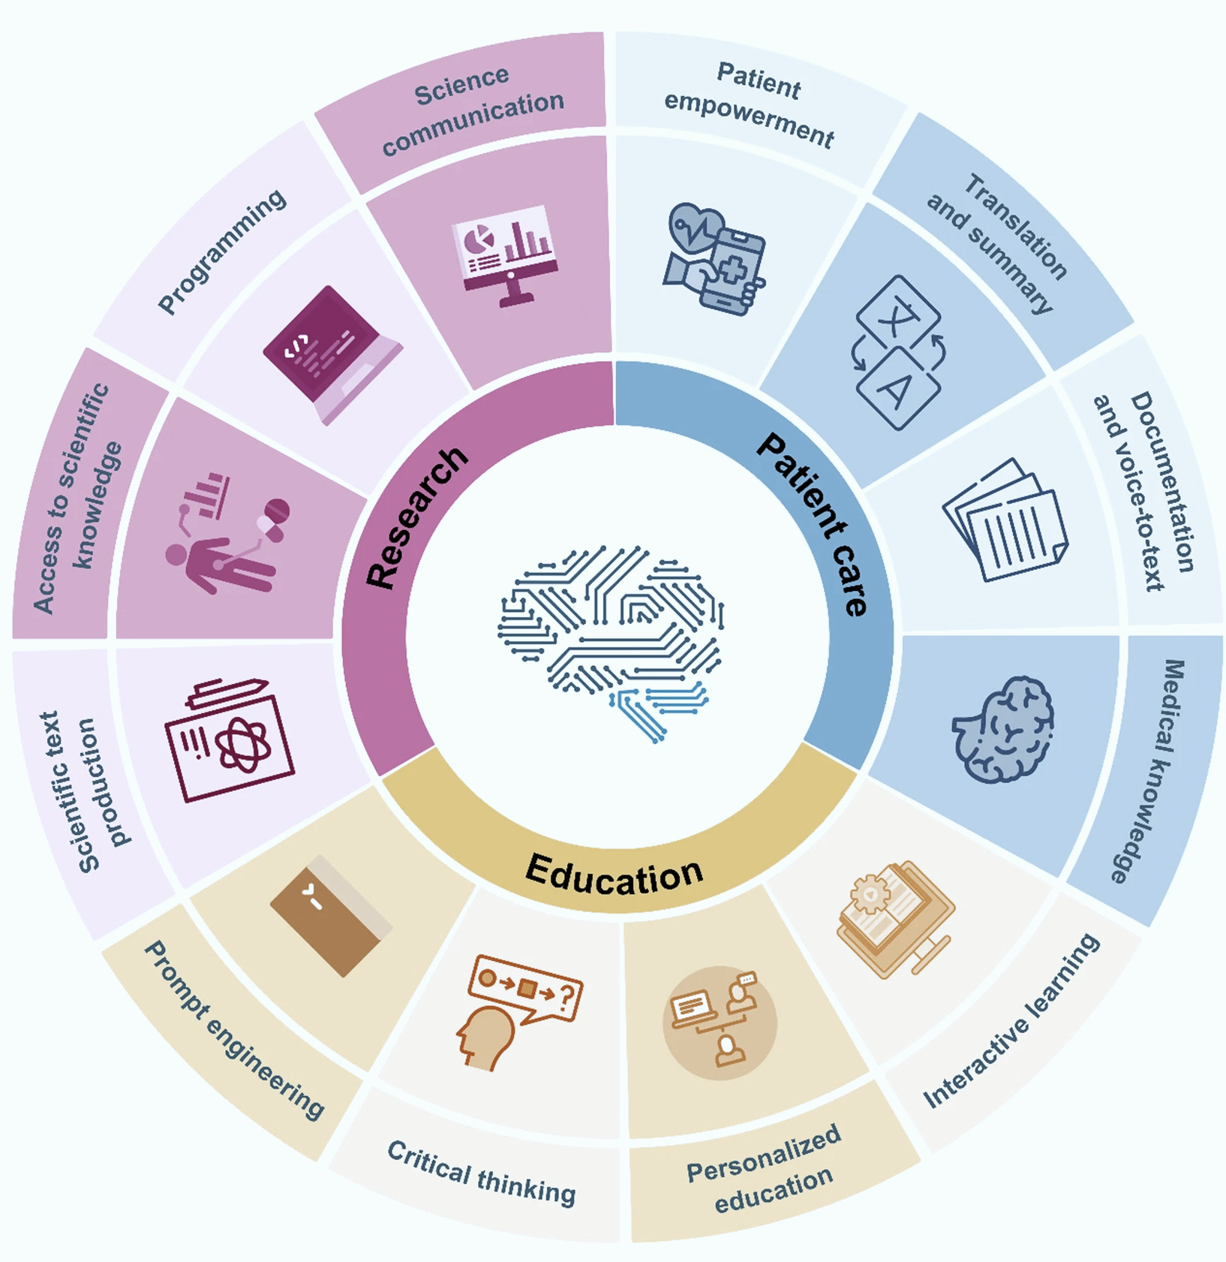
Large Language Models
Large Language Models (LLMs) are a type of Foundation model that are designed for natural language processing tasks.
They leverage deep learning techniques and vast amounts of text data to understand and generate human-like text.
LLM applications include understanding natural language, assisting in content creation, automating help desk or customer support, and various other language-related tasks.
image source – [8]
Company Confidential: Data-Core Healthcare | datacorehealthcare.com
Notes:
The other term that you very often come across when exploring GenAI is a Large Language Model, or LLM.
This is a type of Foundation Model that is being widely used today.
LLMs are advanced AI models which utilize deep learning techniques specifically tailored for natural language processing tasks. They are known for their ability to achieve a general-purpose understanding and generation of human language. The models are trained on vast amounts of textual data, en-compassing the entire spectrum of human language. In essence, they become language experts, learning from the immense text corpus available on the internet and other sources.
LLMs are responsible for producing text that is coherent, contextually relevant, and often in-distinguishable from content created by humans. No wonder, they are becoming a major headache for teachers or professors!
But used properly, LLMs are the enablers of human-like communication, be it for powering chatbots in customer support, or providing 24 by 7 medical information.
In the context of Generative AI, LLMs are the linguistic powerhouses, fueling the creative potential of content generation.

Slide 12
03
GenAI vs. Traditional AI
Company Confidential: Data-Core Healthcare | datacorehealthcare.com
Notes:
As we delve into the realm of Generative AI, it's crucial to understand how it differs from Traditional AI, or the AI that we have been hearing about in the past decade.

Slide 13
How different is GenAI from Traditional AI?
Traditional AI focuses on performing a specific task intelligently. Traditional AI systems are primarily used to analyze data and make predictions, while generative AI goes a step further by creating new data similar to its training data.
Criteria | Traditional AI | Generative AI
Output Type | Predictions with historical training data | Creating content that isn’t part of training dataset
Training Model | Mostly Supervised learning | Primarily Unsupervised learning
Learning Approach | Labeled historical data with known outcomes | Uses GANs and RNNs to learn patterns
Data Requirements | Needs extensive datasets within a specific domain | Needs a lot of data from a broad variety of sources as opposed to a domain-specific source
Adaptability | Can face difficulty in scenarios outside the knowledge they have been trained with | Can create new content without extensive retraining
Company Confidential: Data-Core Healthcare | datacorehealthcare.com
Notes:
GenAI's primary focus is on generating new content, setting it apart from Traditional AI. While Traditional AI typically works with structured historical data and predicts outcomes, GenAI has the unique ability to produce data that wasn't explicitly part of its training dataset. It's like having an AI artist who can create new masterpieces rather than replicating or refining existing ones.
One of the fundamental differences lies in their training and learning approaches. Traditional AI mostly works with supervised learning which uses data labeled by humans to train algorithms that classify that data and predict outcomes. GenAI, on the other hand, learns from datasets without human annotations. It does this by learning intricate patterns within the data much like an artist who learns by observing other’s artwork and practicing over time rather than an artist who is formally trained on how to draw. As mentioned before, this type of learning is called unsupervised learning. GenAI harnesses the power of advanced techniques like Generative Adversarial Networks or GANs and Recurrent Neural Networks or RNNs to create content.
Another distinctive feature of GenAI is its ability to operate effectively with extensive data from a variety of sources while Traditional AI often demands comprehensive data for a specific domain. GenAI focuses on learning patterns within the data to create new content, making it practical for a wide range of applications.
What truly sets GenAI apart is its adaptability. It can navigate unfamiliar situations and create new content without extensive retraining. Traditional AI systems, which rely heavily on labeled, historical data, may struggle when faced with scenarios outside their established knowledge.

Slide 14
04
GenAI in Healthcare
Company Confidential: Data-Core Healthcare | datacorehealthcare.com
Notes:
Well, now that we have some idea of ‘what GenAI is’ and ‘what it does best’, let us move on to some of the possible applications of Generative AI in the healthcare sector. This is the fun part of our journey.

Slide 15
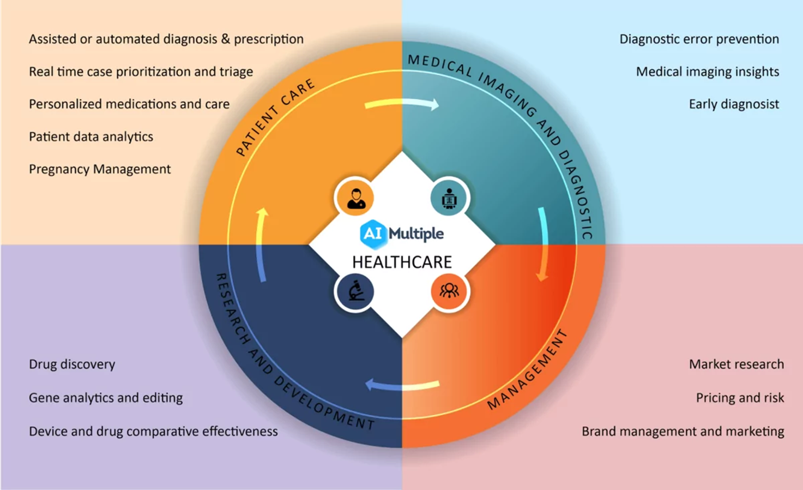
GenAI Applications in Healthcare
GenAI can Interpret and Analyze Unstructured Data for
a variety of Downstream Applications
Reduce Administrative Burden
Automate Routine Processes
Provide 24/7 Access to Medical Information
Facilitate Personalized Patient Care
image source – [9]
Company Confidential: Data-Core Healthcare | datacorehealthcare.com
Notes:
As you all know, Healthcare generates vast amounts of data, from medical notes and patient records to test results and images. This data is mostly unstructured. We have just learnt that GenAI is a master at interpreting and analyzing unstructured data, making it suitable for a variety of different applications. Let us look at a few examples here. Each of these use cases has the potential to bring significant benefits not only to healthcare providers but also to patients.
GenAI can reduce administrative tasks, such as appointment scheduling and documentation. It can also be used to transcribe spoken words into text, make corrections to existing text or to create detailed clinical notes. This frees up the administrative staff to focus on more important matters.
Many routine tasks can also be fully or partially automated. These include Medical Coding, Discharge Summaries, and Triage.
Gen AI can ensure that patients have access to medical information and guidance, around the clock.
It can also offer invaluable diagnostic assistance. By analyzing patient symptoms and medical histories, GenAI can tailor treatment plans, medication regimens, and even medical education materials to individual patient needs.
We will discuss each of these applications a bit more.

Slide 16
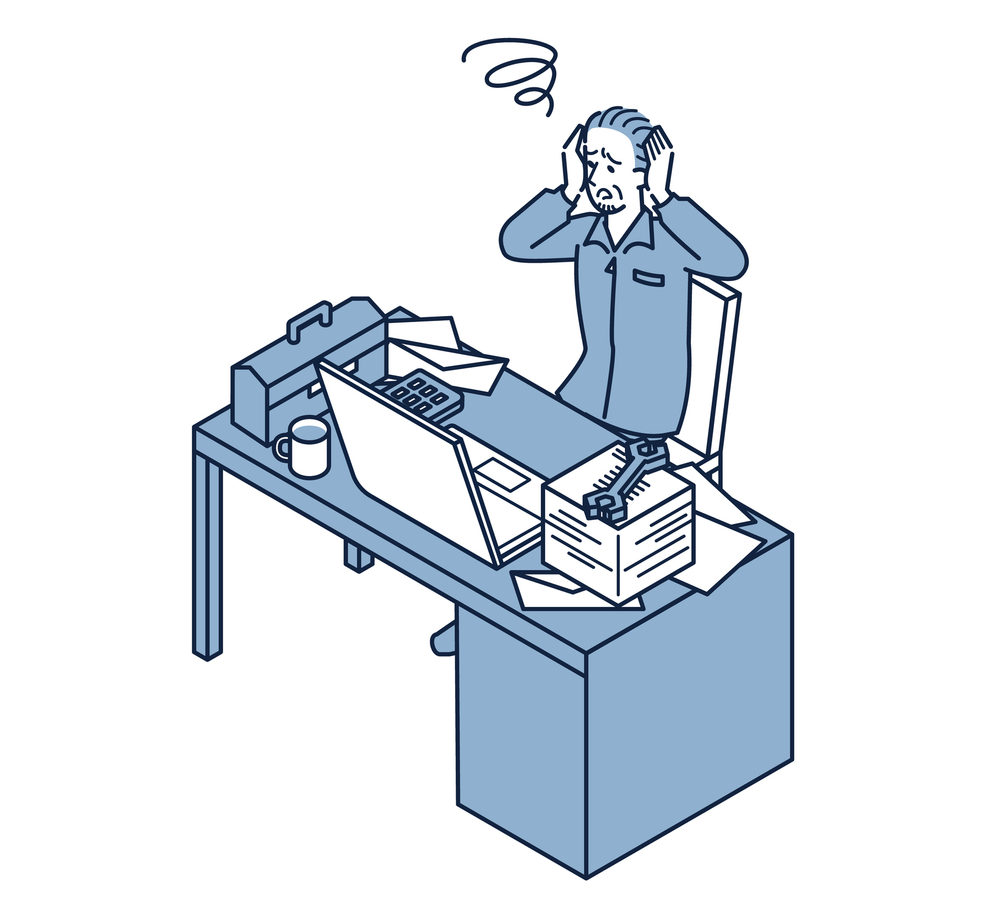
Reduce Administrative Burden
Assist in Patient Scheduling and Calendar Management
Streamline Patient Onboarding
Simplify Documentation
Draft Preauthorization and Appeal Letters
Address common IT and HR Questions
Company Confidential: Data-Core Healthcare | datacorehealthcare.com
Notes:
GenAI can streamline various processes starting from a provider’s calendar management and patient scheduling to onboarding assistance.
It can simplify documentation and create draft preauthorization requests or appeal letters for denied claims. The result? A significant decrease in the time administrative staff spend on these tasks.
But GenAI's automation prowess goes beyond that. It can utilize, for example, IT and HR policies to address common questions from hospital employees on these topics. This enhances the overall employee experience, as they can quickly and efficiently access the information they need.
For all these tasks, relevant material must be fed to the GenAI system for it to interpret, analyze, and learn from.

Slide 17
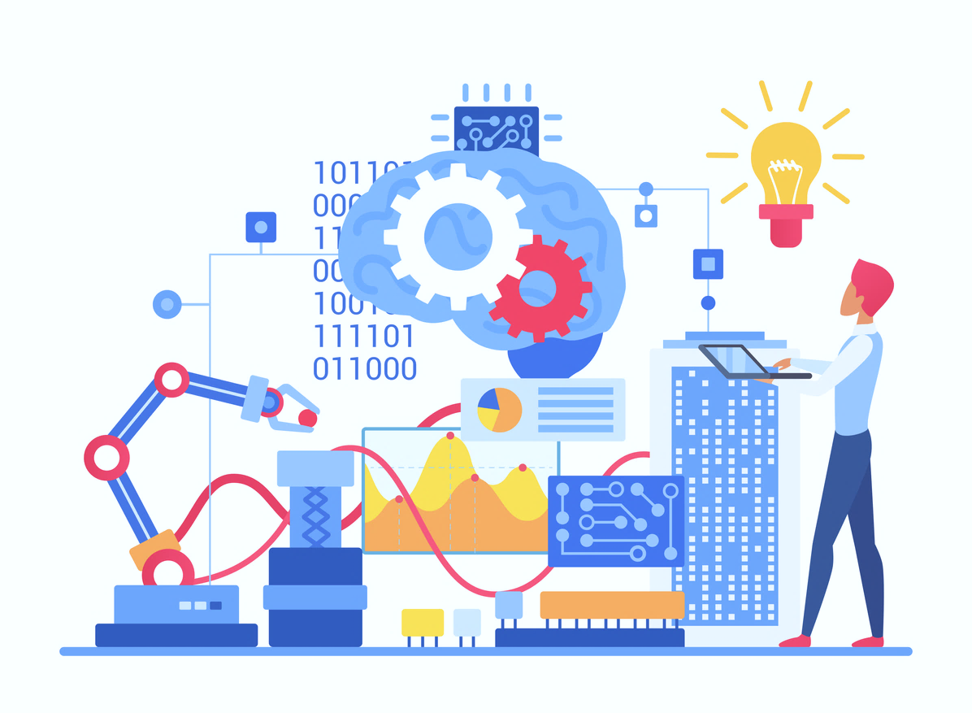
Automate Routine Processes
Provide Benefits Verification & Claim Status
Assist in Medical Coding and Billing
Generate Discharge Summaries
Triage and Prioritize Cases in Real Time
Speed up Drug Discovery
Company Confidential: Data-Core Healthcare | datacorehealthcare.com
Notes:
As already mentioned, Unstructured data can be converted into Structured data by GenAI.
This feature can be utilized to provide near-real-time verification of benefits and finding out the status of claims. Further developments may lead to an accurate calculation of out-of-pocket costs using the providers’ contracted rates and the patients’ benefits.
An integral part of the healthcare revenue cycle is Medical Coding and Generative AI can assist in this process, reducing the time and effort required for manual coding. With its ability to learn and adapt, generative AI can reduce the risk of human errors and ensure that healthcare providers receive prompt payment for their services. However, a final review by expert coders may be required to ensure coding accuracy.
Gen AI could - with clinician oversight - potentially generate discharge summaries or summaries for referrals. It could also synthesize specialist notes for the primary-care physicians.
By asking tailored, relevant questions that mimic human conversations, GenAI-enabled Emergency Rooms can aid in triaging patients. It can also prioritize cases in real time by analyzing the health data collected during the triage process.
With the release of platforms like DALL-E 2 and Midjourney, “Diffusion Generative Models” have achieved mainstream popularity. These models demonstrate the power of GenAI to generate breathtaking and often interesting images from simple text prompts. The same technology can be used to accelerate the development of new drugs and reduce the likelihood of adverse side effects. For example, Gen-AI is already being used to generate several molecular structures that are potential ‘molecular docking’ candidates for a drug. These candidates are then examined by the experts to determine the best fit.

Slide 18
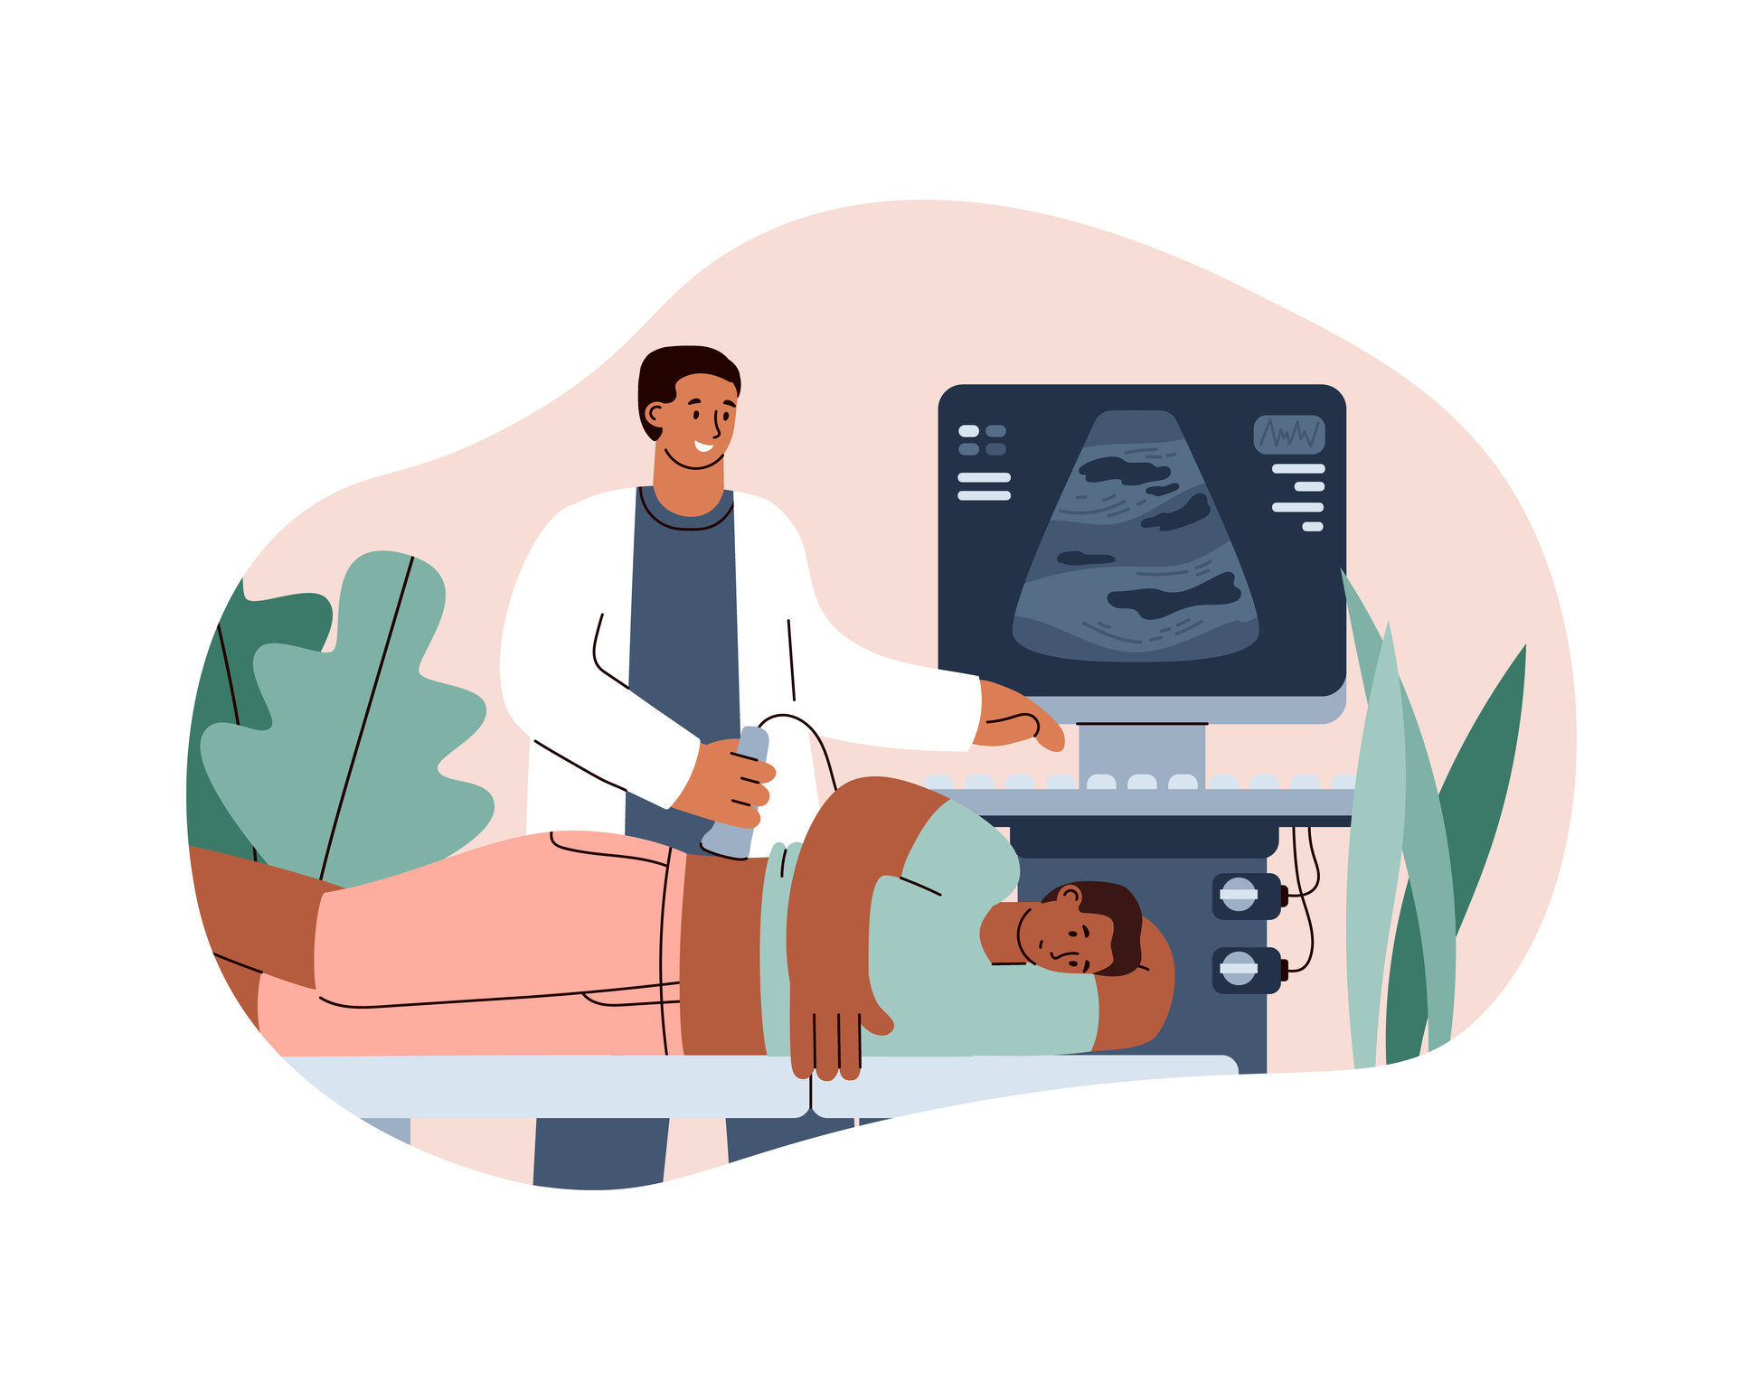
Facilitate Personalized Patient Care
By reviewing a Patient’s Medical History, GenAI can:
Provide Personalized Treatment Recommendations
Forecast Disease Progression Trajectories
Predict Patient’s Response to Treatments
Company Confidential: Data-Core Healthcare | datacorehealthcare.com
Notes:
We have been talking about GenAI’s capability of ingesting a wide variety of data in different media types.
By reviewing and analyzing a patient’s medical history, current health issues and lifestyle, GenAI can formulate:
Personalized treatment recommendations
Predict how a disease might progress
And even predict a patient’s response to certain treatments.
GenAI is also capable of utilizing data from wearables like smartwatches to offer personalized care recommendations
These recommendations, however, must be reviewed by a physician or clinician before communicating with the patient. GenAI is meant to help in the process not replace the expertise of medical professionals.

Slide 19
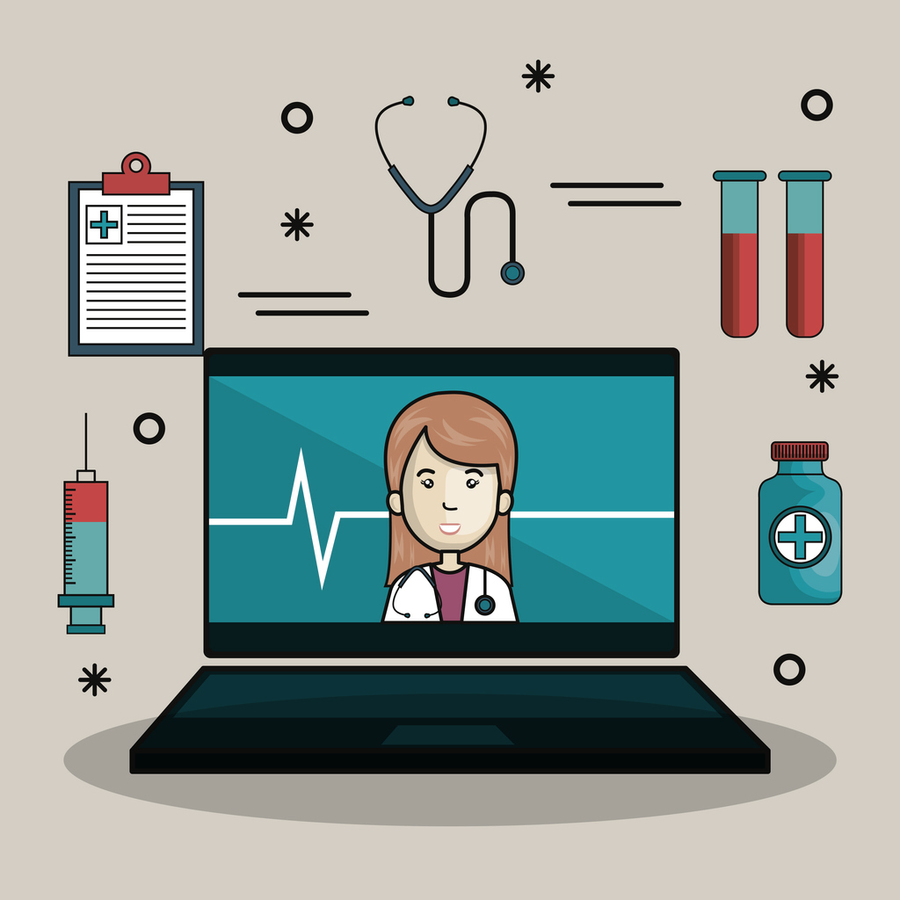
Provide 24/7 Access to Medical Information
Accessing Medical Knowledge 24/7
Round-the-Clock Virtual Assistants
Personalized Health Nudges
Company Confidential: Data-Core Healthcare | datacorehealthcare.com
Notes:
Generative AI can be leveraged to provide on-demand access to medical information. By utilizing its advanced contextual search capabilities, GenAI can provide healthcare professionals and patients with instant access to up-to-date medical information. Whether it's clarifying a medical term, researching a specific condition or symptom, Generative AI ensures that medical knowledge is available 24 by 7.
Virtual assistants can be developed through GenAI. These virtual assistants can interact with patients at any time of day or night. They are like a digital helpline, ready to answer questions and provide information and guidance in a variety of ways. But a word of caution here – such systems should be thoroughly examined by experts to ensure that proper information is being provided to the patients. Additionally, when there is any hint of a critical condition within the patient dialog, the system must be trained to refrain from providing any further information and refer the patient to a professional.
GenAI enables personalized health nudges These can be delivered through various channels like mobile apps or messaging platforms. They are tailored to an individual's health needs and behaviors, encouraging them to adopt healthier habits and make informed choices. For example, a personalized nudge might remind patients to take their medication, encourage them to engage in physical activity, or provide dietary guidance. This personalized approach fosters patient engagement and enhances overall health outcomes.

Slide 20
Other Use Cases of GenAI in Healthcare
Medical Imaging
Predictive Maintenance of Medical Devices
Preventing Medical Errors
Medical Research
Company Confidential: Data-Core Healthcare | datacorehealthcare.com
Notes:
Let’s look at some other Use Cases of GenAI in the Healthcare industry. By now you must have a pretty good idea of the capabilities of GenAI, so we will just touch upon these without getting into too much details.
When it comes to medical imaging, Generative AI can play a crucial role in its interpretation. This capability speeds up the physician review process.
The healthcare industry relies on a multitude of medical devices, and Generative AI can be trained to predict when these devices may require maintenance or replacement.
Generative AI can analyze patient data and medical histories to flag potential issues, such as drug interactions or allergy risks. This proactive approach enhances patient safety.
While there is no dearth of healthcare data, the data is not always available to researchers and data scientists due to privacy concerns. The only way out is the use of synthetic data. GenAI, with its creative abilities, can serve that essential purpose, thus preserving patient privacy while advancing medical research and innovation.

Slide 21
05
Managing the Risks of GenAI
Company Confidential: Data-Core Healthcare | datacorehealthcare.com
Notes:
We have covered a variety of possible applications of Generative AI in healthcare. But with any new technology comes its own share of risks. We will discuss some of these.

Slide 22
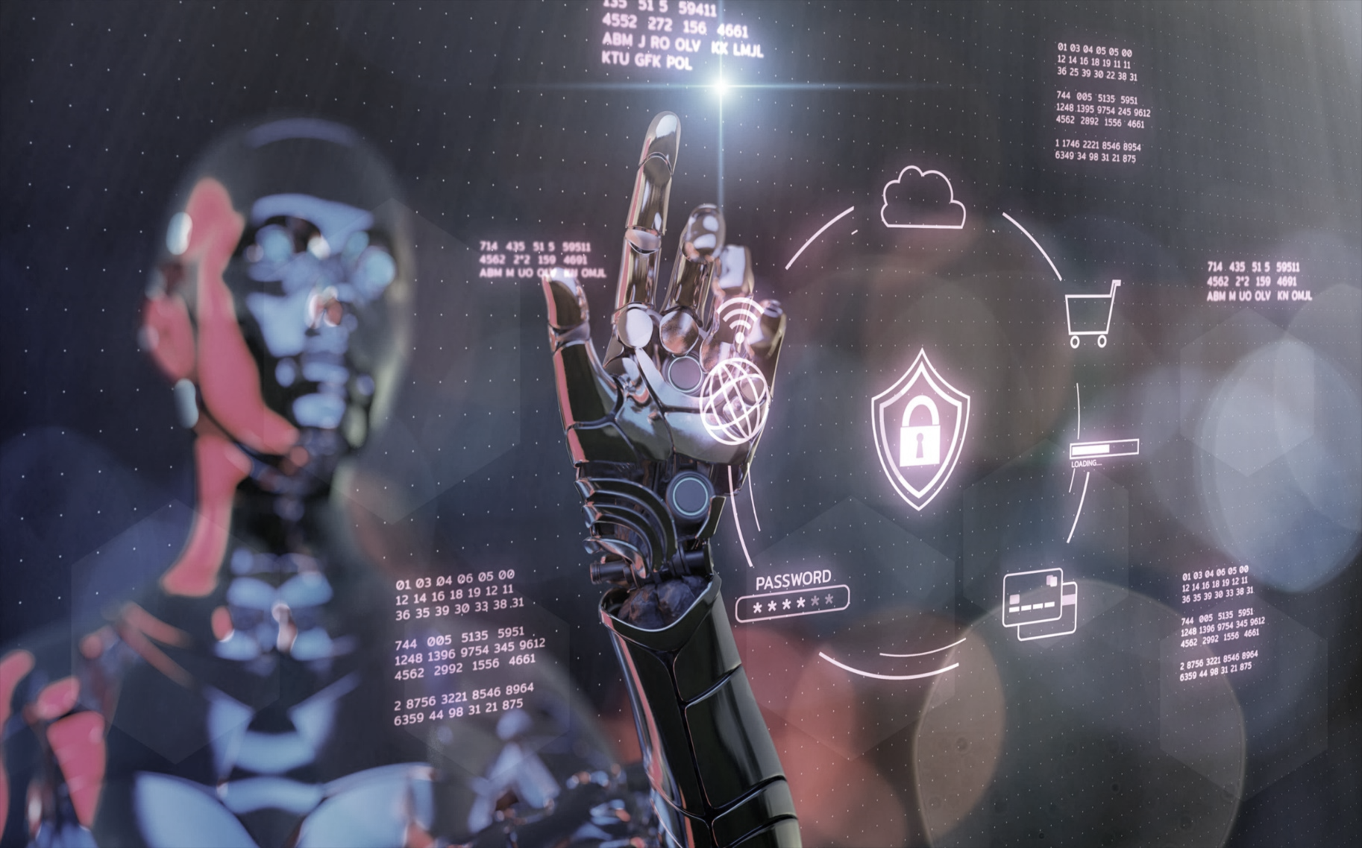
Regulation & Privacy Challenges
The rapid evolution of LLMs and GenAI challenges their clinical evaluation, regulation, and certification.
The ever-evolving nature of medical/clinical knowledge requires a matching form of GenAI that can be continually and reliably trained
and updated.
Patients and healthcare professionals should have a basic understanding of how GenAI-generated content is created and the sources of data it relies on.
Company Confidential: Data-Core Healthcare | datacorehealthcare.com
Notes:
The more recent a model’s version is, the better it tends to perform, but this is not always guaranteed – it must be validated!
Large language models trained on medical information will similarly have multiple successive versions over short periods of time. But clinical evaluation and certification take time, so there is always a risk that by the time an evaluation is completed, the model that is being evaluated has already changed substantially with the release of a new version. Regulatory bodies must keep pace with technology to ensure that any solution available to the public is vetted by experts.
It is also necessary for Generative AI models to incorporate the latest in medical or clinical knowledge to be able to provide the best recommendations. Hence, GenAI models, especially in healthcare, must be continuously trained with new and updated information.
Another major challenge is the trustworthiness of GenAI generated content. Healthcare professionals must be able to understand what data is being used and how the content is being created in order to build trust.

Slide 23
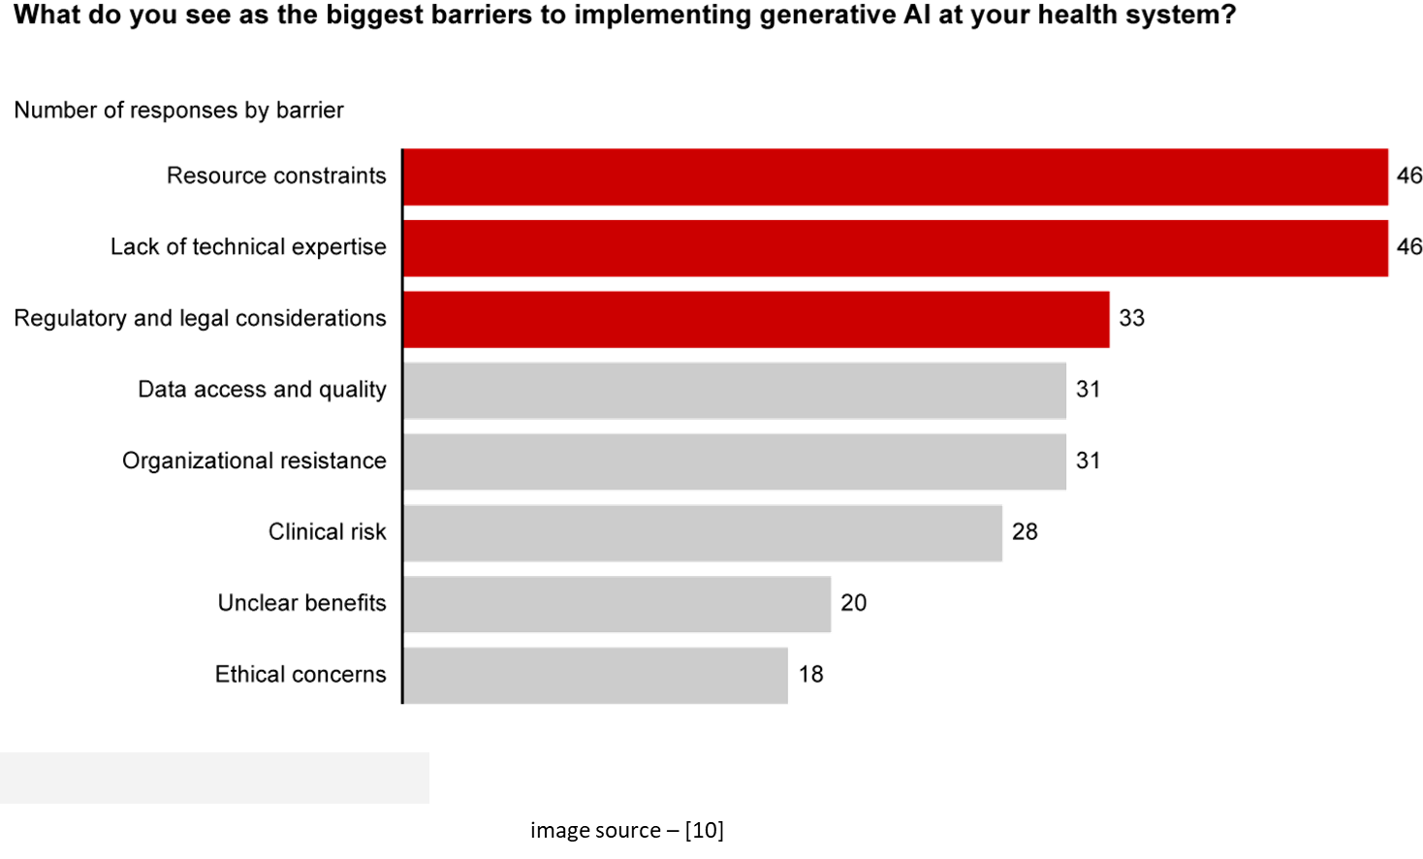
Managing The Risks of GenAI
False Results
Patient Privacy
Opaque Results
Overreliance
Bias
Company Confidential: Data-Core Healthcare | datacorehealthcare.com
Notes:
The risks of GenAI are as varied as the applications. Being aware of these risks will allow you to use GenAI effectively and safely.
Generative AI technology is still evolving and can sometimes generate results that are simply wrong - a phenomenon known as hallucinating. Human review of output is, therefore, essential in any critical application.
Patient health data is sensitive and must be handled with extreme care. GenAI solutions must clarify data ownership, adhere to patient privacy, and look beyond sensitive patient information to the creation and use of synthetic data during the development phase.
As with any AI technology, GenAI also operates as a black box, making it unsettling to some users. To build trust and increase adoption rates, GenAI solutions must clarify how a given algorithm works and how a specific set of data leads to an outcome.
Patients may rely too heavily on information generated by GenAI. Providers and payers must clarify how specific solutions should be used, with clear messaging that AI-generated insights are recommendations rather than mandates.
Because Foundation Models stem from only a few core technologies, inherent biases in these models might spread through every AI application based on them.
The graph on the right depicts the results of a survey conducted by Bain & Company. Health system executives were asked what they see as the biggest barriers to implementing Generative AI in their health system. The top three responses were resource constraints, lack of technical expertise, and regulatory and legal considerations.

Slide 24
06
What can GenAI do for You?
Company Confidential: Data-Core Healthcare | datacorehealthcare.com
Notes:
Now to the most important question – what can this technology do for you?

Slide 25
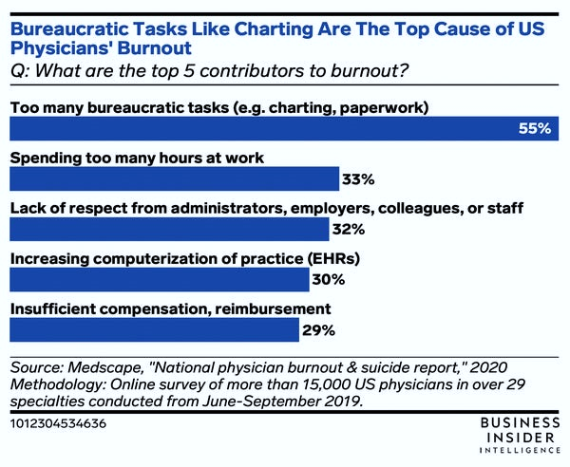
How GenAI can Help You
Healthcare providers are facing staff burnout, staffing shortages, and financial challenges.
GenAI can simulate human-like interactions at a fraction of the cost.
GenAI can assist in routine but critical tasks.
GenAI can create a variety of artifacts based on its knowledge base.
You must decide which problem to solve first.
You can do it! Generative AI can Help!!!
image source – [11]
Company Confidential: Data-Core Healthcare | datacorehealthcare.com
Notes:
Staff Burnout and Turnover in Healthcare directly affects productivity and operational efficiency. Healthcare organizations are also facing unprecedented financial challenges.
Introducing Generative AI into the healthcare landscape has the potential to address these challenges. Imagine an AI solution available 24 hours a day, 7 days a week, 365 days a year! This support becomes invaluable for healthcare organizations in offloading some of their burden.
The capability of Chatbots to simulate human-like interactions can be utilized by contact centers for more common Level-1 interactions.
Assisted Medical Coding or an Automated Triage can not only significantly reduce manual effort but also allow your staff to perform higher level patient care functions.
As you have seen, GenAI has the capability to analyze, interpret, summarize, and create documents or other types of media from the knowledge the models have been trained on. You can utilize this capability in myriad ways in your organization to streamline your processes and improve your bottom-line.
“You, of course, can do it. Generative AI is here to Help!”

Slide 26
Our AI-Driven Products
EOB Converter
Denial Manager
Automates EOB File Conversion
Say goodbye to manual data entry. Our converter automates EOB file conversion.
Streamlines Payment Posting
Efficiently streamline payment posting processes.
Advanced Analytics
Leverage advanced analytics to analyze denial patterns.
Improved Collections
Improve collections and time to collect through reduced denials.
Coding Assistant
Patient Assistant
Prompts Diagnostic and Procedure Codes
Interprets patient chart to prompt appropriate ICD and CPT codes.
Answers common questions
Chatbot designed to interact with patients in a human-like fashion.
Company Confidential: Data-Core Healthcare | datacorehealthcare.com
Notes:
With the expertise of our data scientists trained in AI techniques, we at Data-Core Healthcare have successfully developed some AI-based solutions. We are continuously exploring ways to enhance processes through AI Tools while maintaining or improving on the quality.
With the help of AI/ML algorithms, we are now able to convert paper EOBs to digital data streams like EDI-835. This reduces manual effort thereby streamlining the payment posting process.
Data-Core Healthcare has harnessed the strength of AI/ML to work in tandem with a traditional Rules-based module to predict the probability and most-likely reasons for the denial of claims.
Other products that are under development include a Coding Assistant and a Chatbot for interacting with Patients. These solutions utilize Generative AI technology.

Slide 27
How can Data-Core Healthcare Help?
Let us start by having a discussion to understand your pain points
Determine how Generative AI can address the pain points
Collaboratively Develop a Proof of Concept
Implement Final Solution working Closely with you
Company Confidential: Data-Core Healthcare | datacorehealthcare.com
Notes:
At Data Core Healthcare, we're not just service providers, we're strategic allies in your journey towards achieving maximum efficiency through AI.
Our process begins with an insightful discussion to understand your unique challenges.
Leveraging our expertise, we align our AI solutions to your needs.
We then transition to a customized Proof of Concept that seamlessly integrates into your workflows.
The implementation phase is not performed in isolation but through active collaboration and close partnership with you.
At Data Core Healthcare, we offer more than a solution - we provide a transformative experience, standing with you in the pursuit of elevated patient care and operational excellence. Thank you for considering us as your partner.

Slide 28
Thanks!
Contact:
Sampurna Dhar
sampurna.dhar@datacoresystems.com
C: 416-427-8632
Company Confidential: Data-Core Healthcare | datacorehealthcare.com
Notes:
Thanks again for taking time out of your busy schedule to join us in exploring this newest technology.
Sampurna is your point of contact, and her information is provided here. If you would like to have a copy of this presentation, please let Sampurna know, and we will be happy to provide you with a copy.

Slide 29
Questions?
Company Confidential: Data-Core Healthcare | datacorehealthcare.com
Notes:
We now open the floor for your questions. I will hand over to Sampurna to mediate this segment.

Slide 30
References
[1] https://architechtures.com/en/1661/
[2] https://www.linkedin.com/pulse/what-turing-test-artifical-intelligence-ai-become-bob-west-mba/
[3] https://ashley-mangtani.medium.com/everything-you-need-to-know-about-generative-ai-849ffb41e695
[4] https://www.bcg.com/publications/2023/generative-ai-in-medtech
[5] Tackling healthcare’s biggest burdens with generative AI | McKinsey
[6] The Pulse of AI Adoption in Healthcare : 2023 Becker’s-Zoom Leadership Survey
[7] https://thebabar.medium.com/essential-guide-to-foundation-models-and-large-language-models-27dab58f7404
[8] https://www.nature.com/articles/s43856-023-00370-1
[9] https://research.aimultiple.com/healthcare-ai-use-cases/
[10] https://www.bain.com/insights/getting-the-most-out-of-generative-ai-in-healthcare/
[11] https://www.insiderintelligence.com/insights/ai-in-healthcare-administration-report/
Company Confidential: Data-Core Healthcare | datacorehealthcare.com

